Slide 1
Topic 15
Cloud

Slide 2

Agenda
Cloud computing initial concepts
Service models
Deployment models
Cloud providers
Google app engine

Slide 3
What is cloud?
Cloud is a collection off computational resources and technology services that are delivered on-demand over Internet.
These resources are mainly storage, processing power, network.

Slide 4
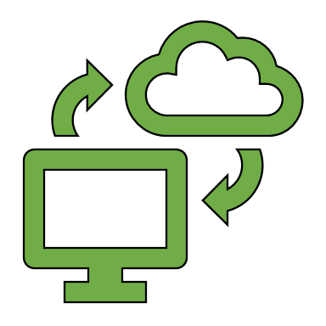

Example
VS
Traditional scenario
Cloud

Slide 5
Cloud benefits
Less Cost
Scalability
Agility
Location Independence
Multi-tenancy
Reliability
Maintenance is easier

Slide 6
Cloud computing techniques
Service Oriented Architecture (SOA)
Virtualization

Slide 7
Service Oriented Architecture (SOA)
SOA is an architectural pattern that make software components reusable via service interfaces.
It makes applying changes in the system easier.
SOA works modularly.

Slide 8
Virtualization
Virtualization is a technique that separates a service from the underlying physical delivery of that service.
The cloud provides the resources for users and share it with them using virtual machines.
These resources include, Hardware (memory, CPU, storage), software, data and network.

Slide 9
Cloud service models
Software as a service
SaaS
Platform as a service
PaaS
Infrastructure as a service
IaaS

Slide 10
IaaS (Infrastructure as a Service)
Application
data
The lowest layer of cloud service model with maximum flexibility for the users.
Examples: Amazon EC2, Google Compute Engine, Windows Azure,
Manageable
by user
runtime
middleware
Operating systems
Virtualization
Offer by
provider
Physical resources (servers, storage, network )

Slide 11
PaaS(Platform as a Service)
Application
Manageable
by user
data
Users can create their own applications
Examples: Google App Engine, AWS Elastic Beanstalk, Heroku
runtime
middleware
Offer by
provider
Operating systems
Virtualization
Physical resources (servers, storage, network )

Slide 12
SaaS (Software as a service)
Application
data
Users can use existing applications running on cloud
Examples: Webmail(gmail, yahoo, …), web applications (Google Docs,…) Dropbox, Salesforce, Instagram
runtime
All offer by provider
middleware
Operating systems
Virtualization
Physical resources (servers, storage, network )

Slide 13
Deployment models
Public Cloud: Public cloud are owned by third parties and its services are available publicly accessible through internet. Examples: AWS, Azure, GCP
Private Cloud: A private cloud consists of computing resources used exclusively by one business or organization. The computing resources are isolated and delivered via a secure private network.
Hybrid Cloud: The combination of public and private deployments models.

